Slide 1
YOUR LOGO HERE
BRed merchandise
Corporate & promotional gifts
Sustainable giveaways
See 2023 catalogue
trendy | creative | sustainable | aspirational

Slide 2
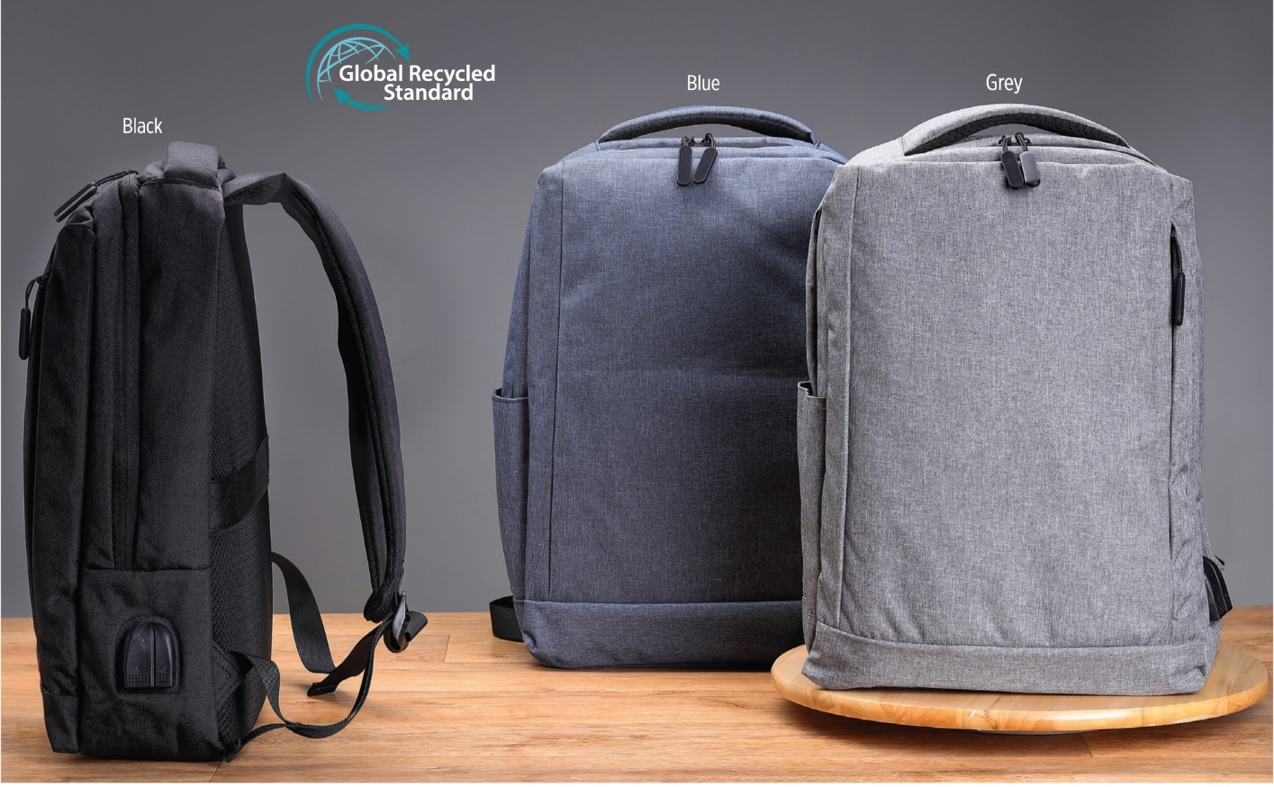
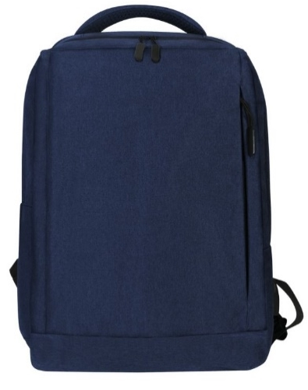
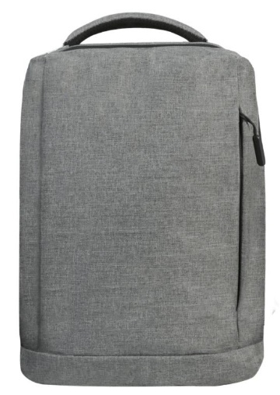
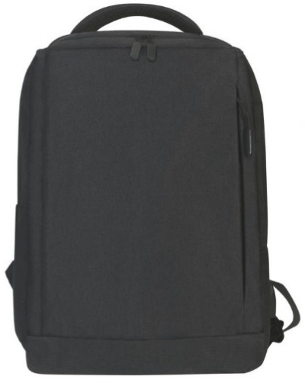
Baruth - Giftology GRS-certified Recycled RPET Backpack
Made from GRS Certified rPET
Modern minimalist design
Quantity | Unit Price
100 | R
250 | R
500 | R
Notes:
BPGL 676, BPGL 675, BPGL 674

Slide 3
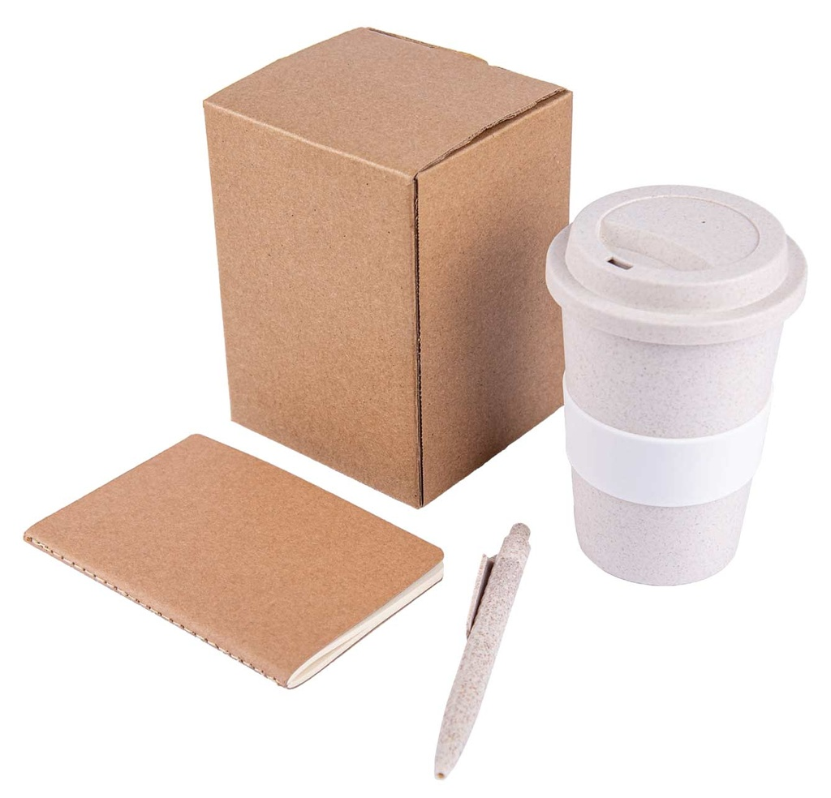
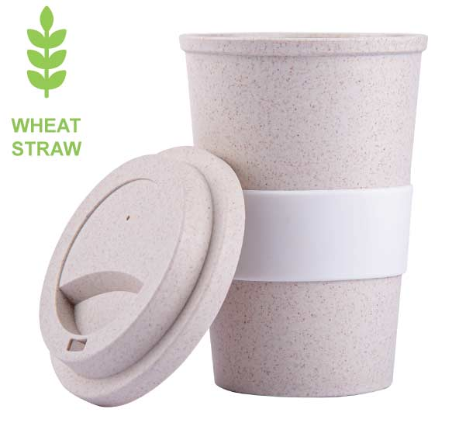
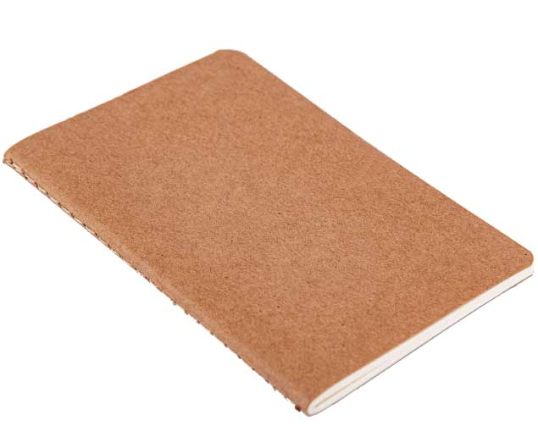
Korgan Eco Set of Mug, FSC Notebook and Pen
All products plus packaging from sustainable materials
Silicone sleeve helps hold mug with hot liquid
80 pgs Notebook - 14 x 9 cm
Give Value, Save Ecology when you give out this set
380 ml Mug capacity
Quantity | Unit Price
100 | R
250 | R
500 | R
Notes:
GSEN 681

Slide 4
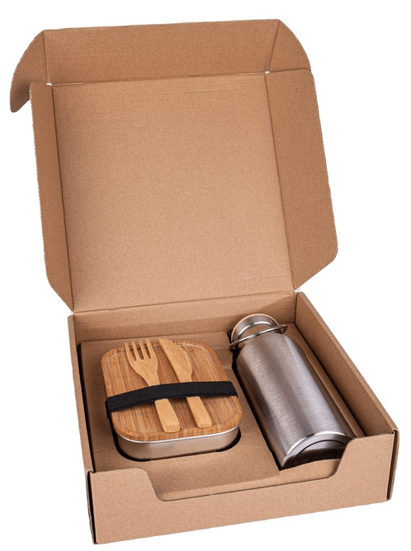
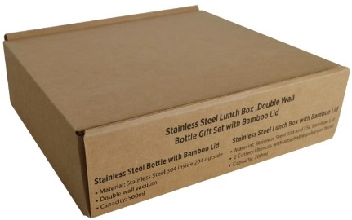
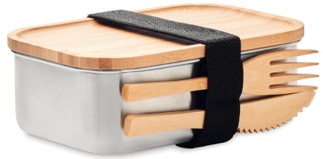
Chaves Lunch Box and
Vacuum Bottle
Bamboo & Packaging-sustainable
Double wall stainless steel insulating vacuum flask with bamboo lid and handle
Stainless steel lunchbox with 2 cutlery utensils and an attachable polyester band
Quantity | Unit Price
100 | R
250 | R
500 | R
Notes:
GSHL 180

Slide 5
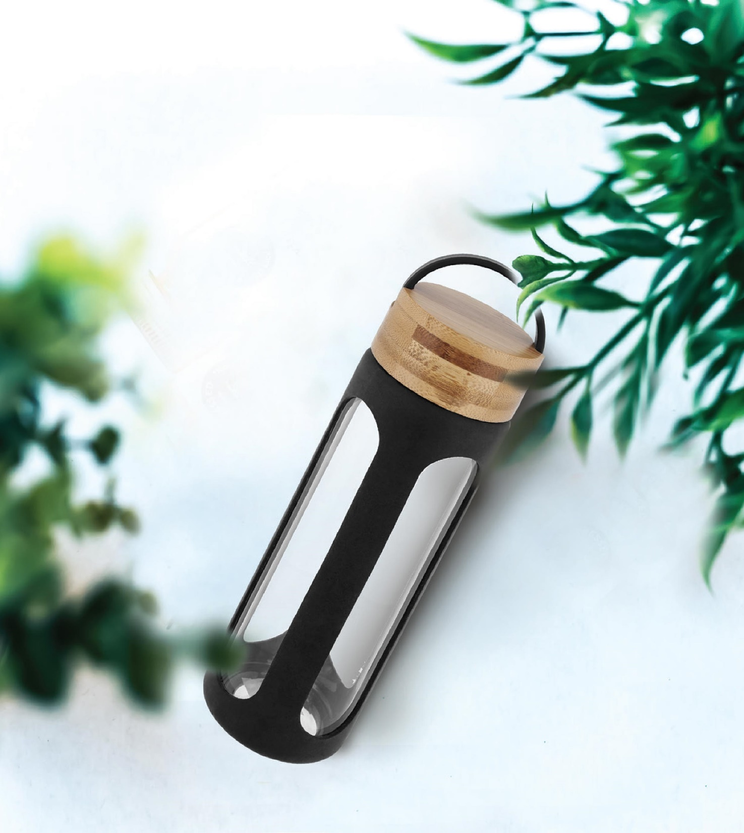
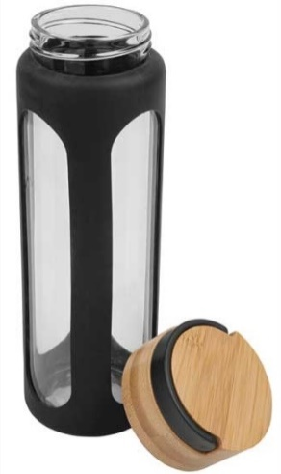
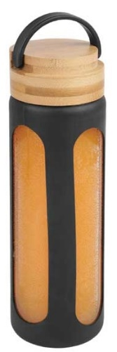
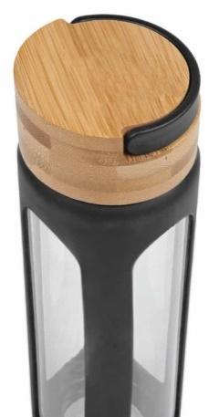
Megara Borosilicate 550 ml
Glass Bottle
Borosilicate Glass Body & Eco Bamboo Top Cap
Silicon Sleeve For Protection
Eco-Friendly
Quantity | Unit Price
100 | R
250 | R
500 | R
Notes:
DWHL 502

Slide 6
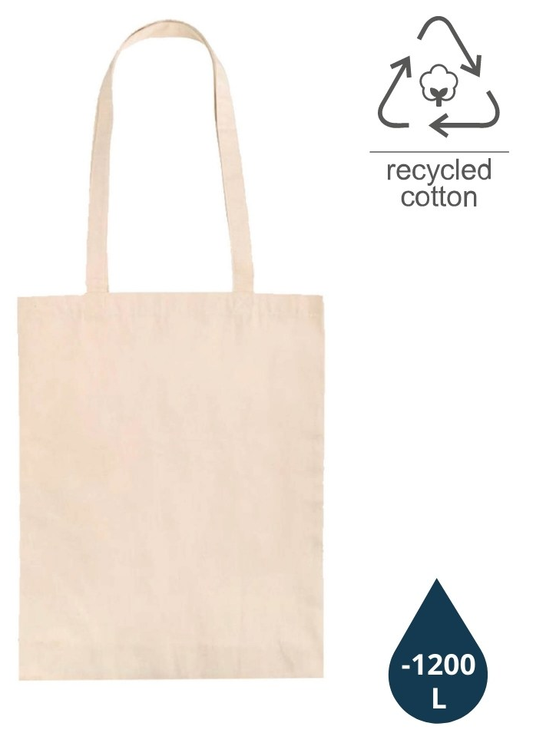
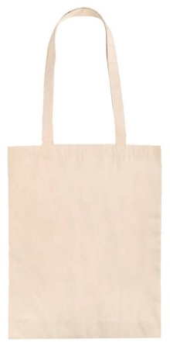
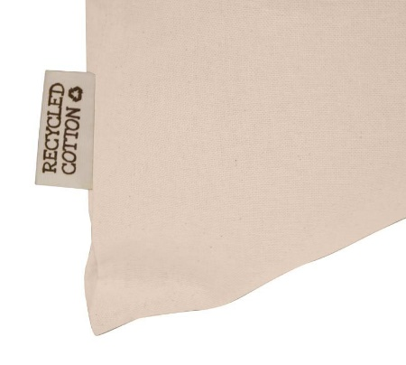
Ablar - GRS-certified Recycled Cotton Tote Bag – 140GSM
Certified by Global Recycled Standard (GRS)
Made with 140GSM recycled cotton - a light and durable fabric.
Saved 1,200 L of water by substituting water-thirsty cotton fabric with recycled cotton.
Quantity | Unit Price
100 | R
250 | R
500 | R
Notes:
CTEN 421

Slide 7
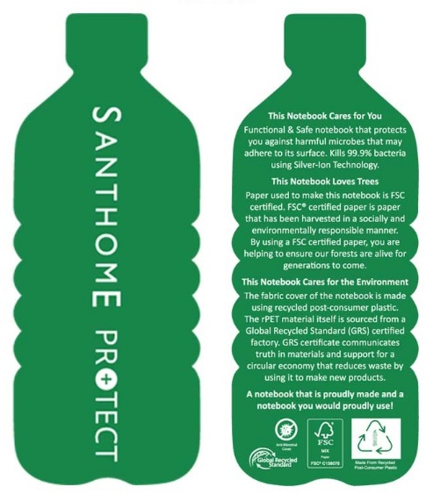
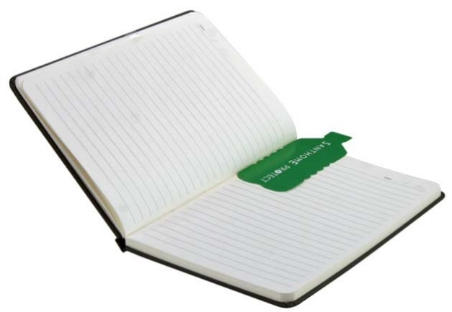
Orsha Santhome A5 RPET &
FSC -certified Notebook
Cover made from recycled plastic (rPET) & treated with silver-ion Anti-Bacterial Technology
FSC Certified Paper
A5 Ruled Notebook, 160 Pages.
Quantity | Unit Price
100 | R
250 | R
500 | R
Notes:
NBSN 341, NBSN 342, NBSN 343

Slide 8
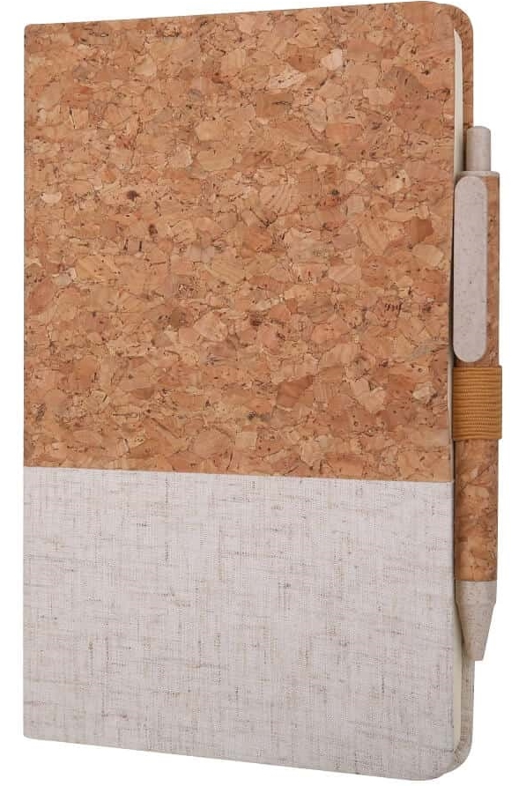
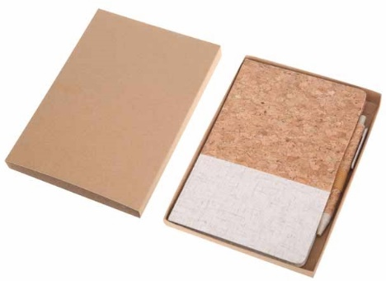
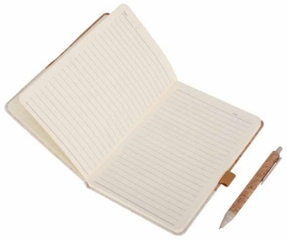
Borsa Eco-neutral A5 Cork Fabric Hard Cover Notebook and Pen Set
Notebook made from elegant combination of cork and cotton fabric. 160 pages
Pen made from cork and wheat straw material with matching colours
Packed in an eco gift box
Quantity | Unit Price
100 | R
250 | R
500 | R
Notes:
NBEN 103

Slide 9
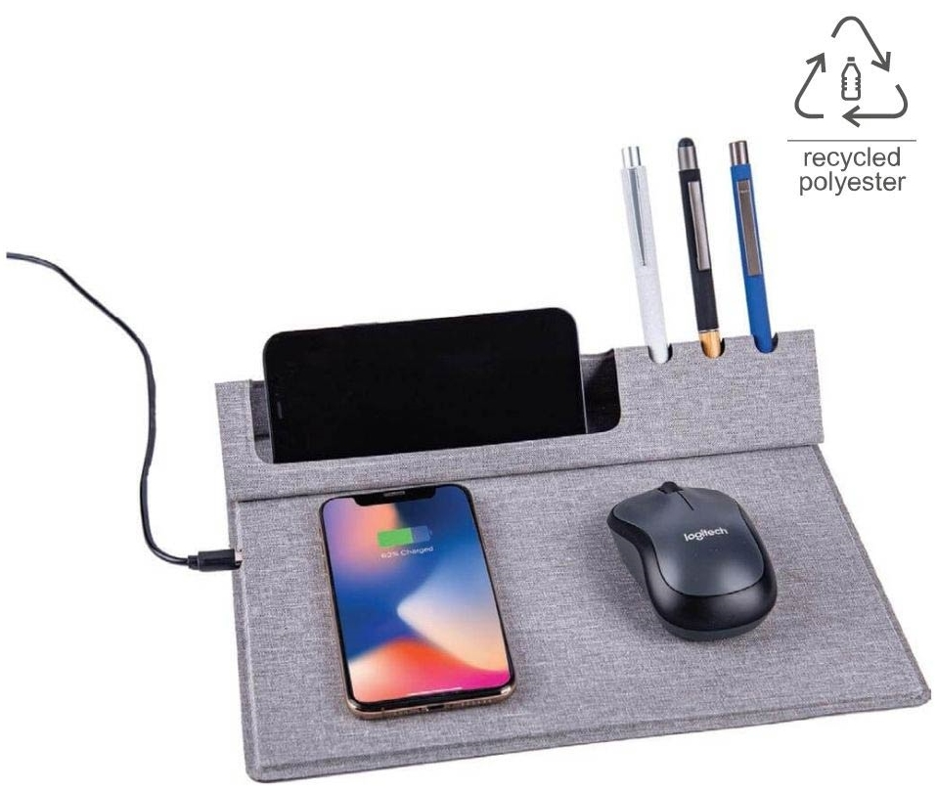
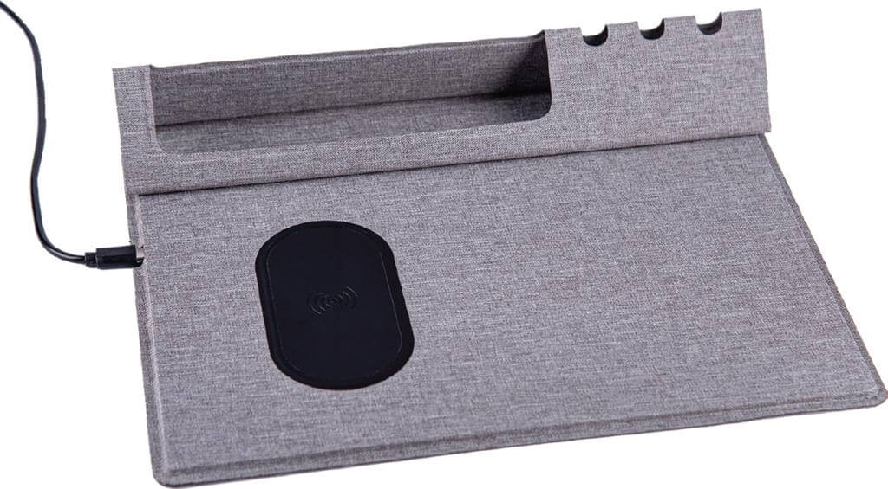
Vani Mouse Pad & Desk Organizer
Eco Friendly RPET Material
10 Watts Wireless Charger
With Mouse pad, Desk Stand
Elegant Fabric gives a Rich appearance
Folds completely, hence a Travel-friendly accessory
Quantity | Unit Price
100 | R
250 | R
500 | R
Notes:
ITWC 154

Slide 10
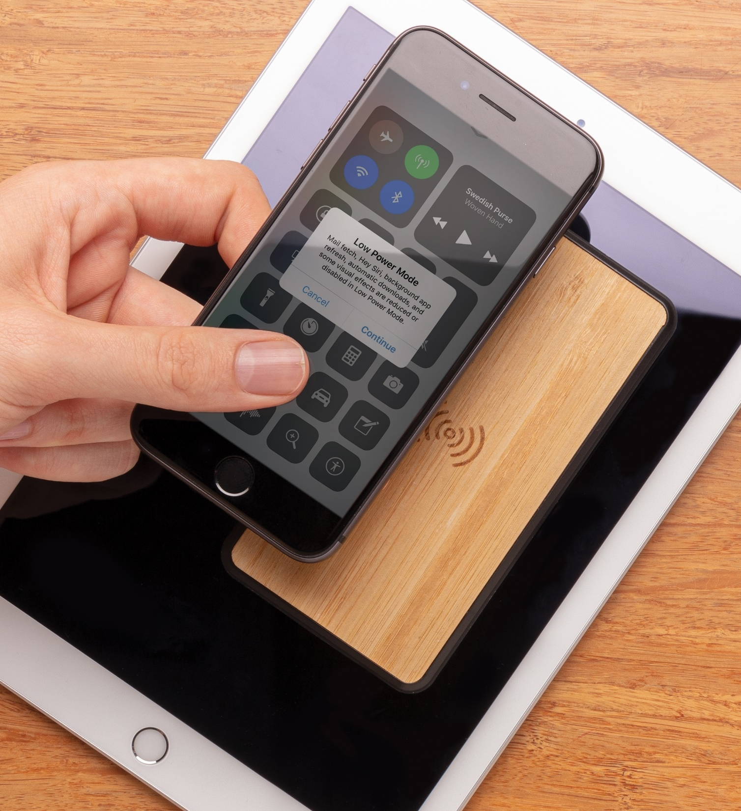
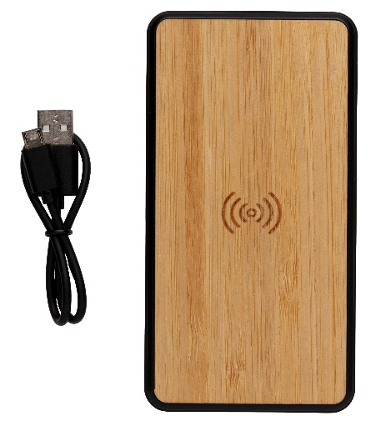
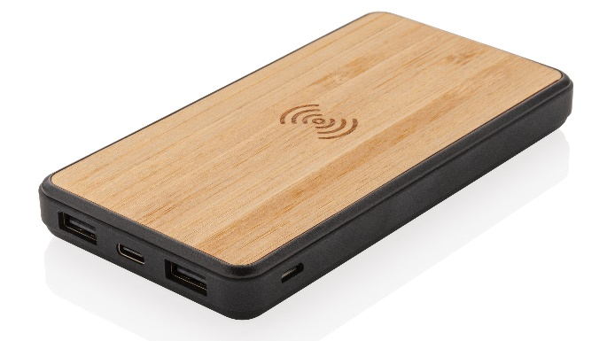
Askas Bamboo 8000mAh Wireless Powerbank
Treated with Biomaster Antimicrobial Technology from the UK
FSC Certified Bamboo
Fashion 8000 mAh Wireless Powerbank
Quantity | Unit Price
100 | R
250 | R
500 | R
Notes:
ITPB 837

Slide 11
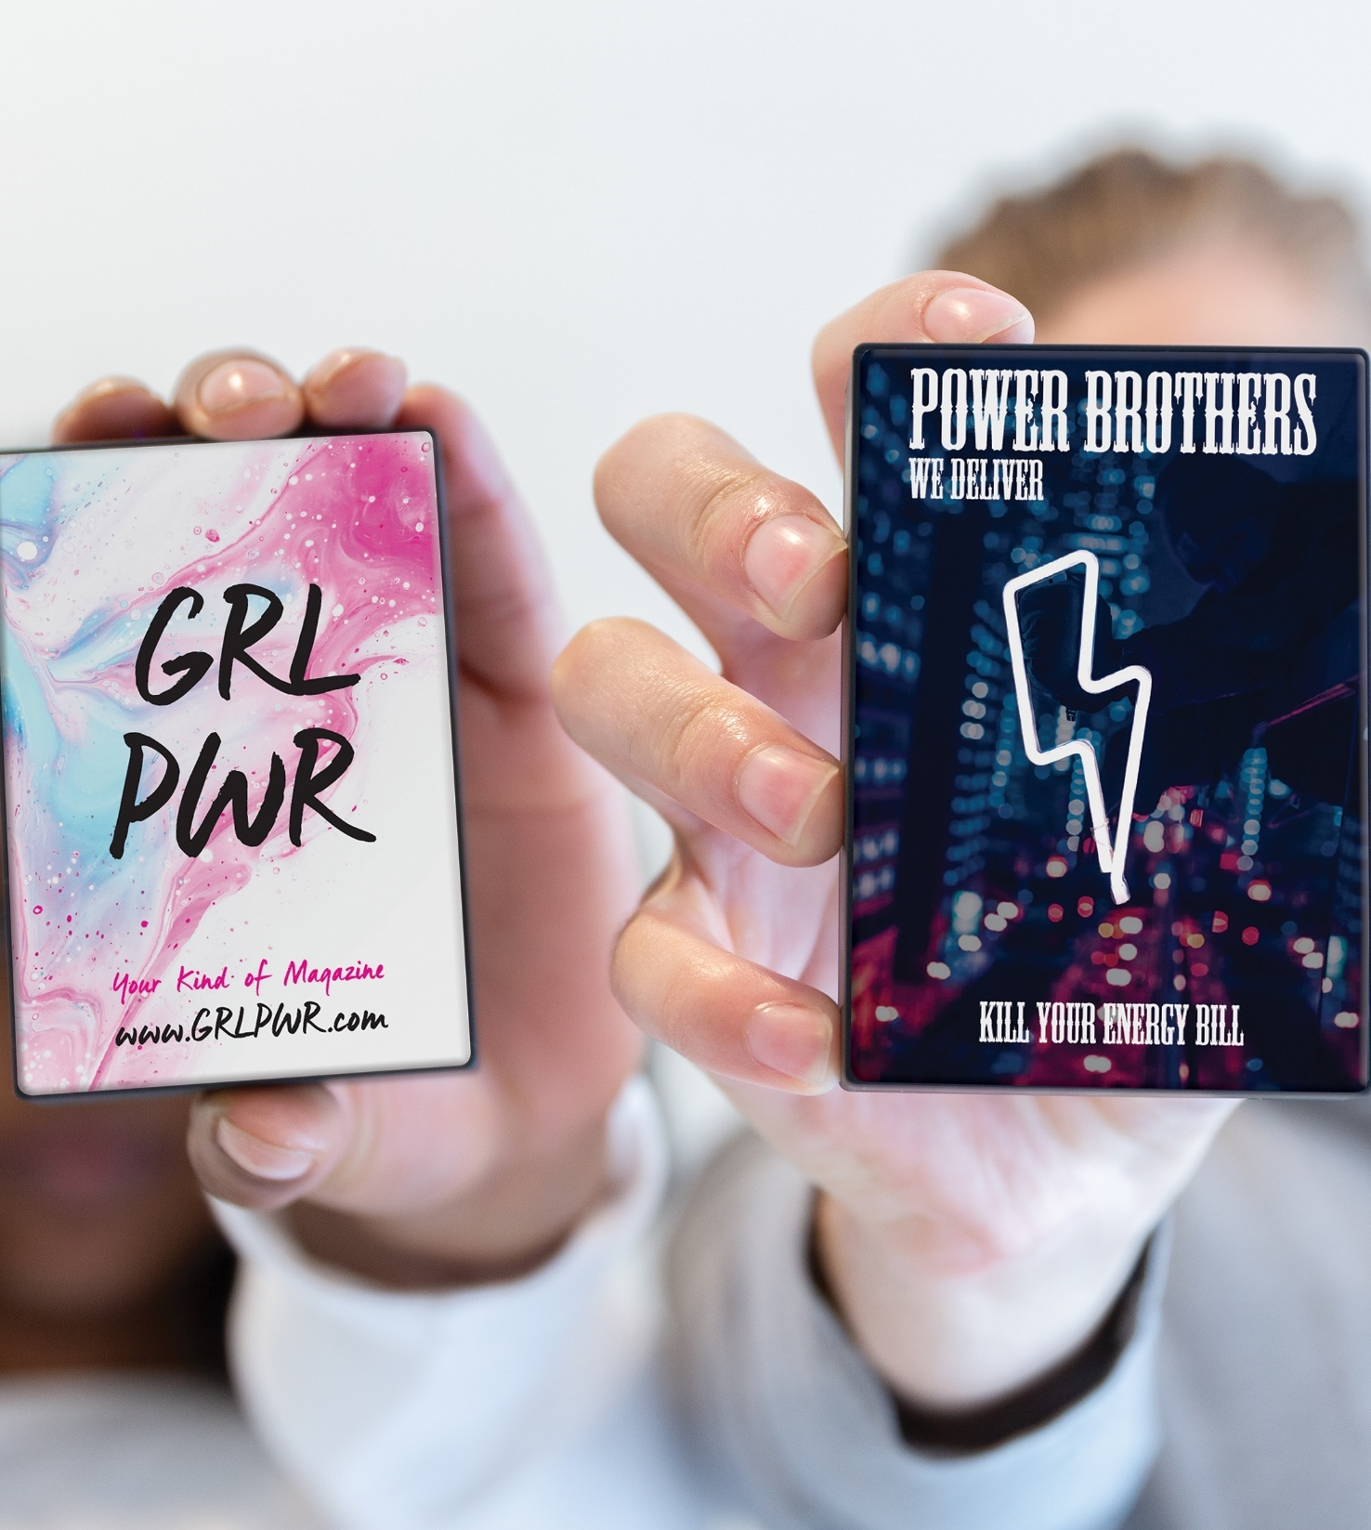
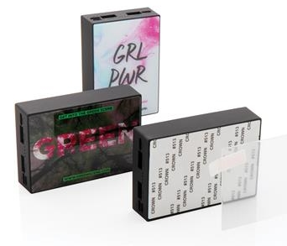
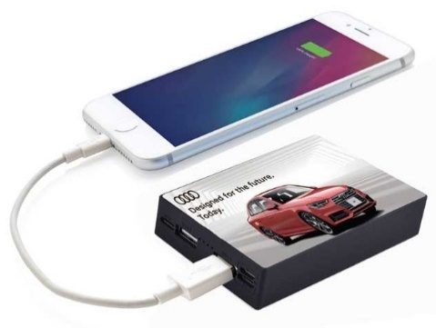
Rodez Tempered Glass 10,000mAh Powerbank
Excellent BRing Space on Tempered Glass Surface
Latest Type-C Input & Output
Capacity : 10,000 mAh
Quantity | Unit Price
100 | R
250 | R
500 | R
Notes:
ITPB 823

Slide 12
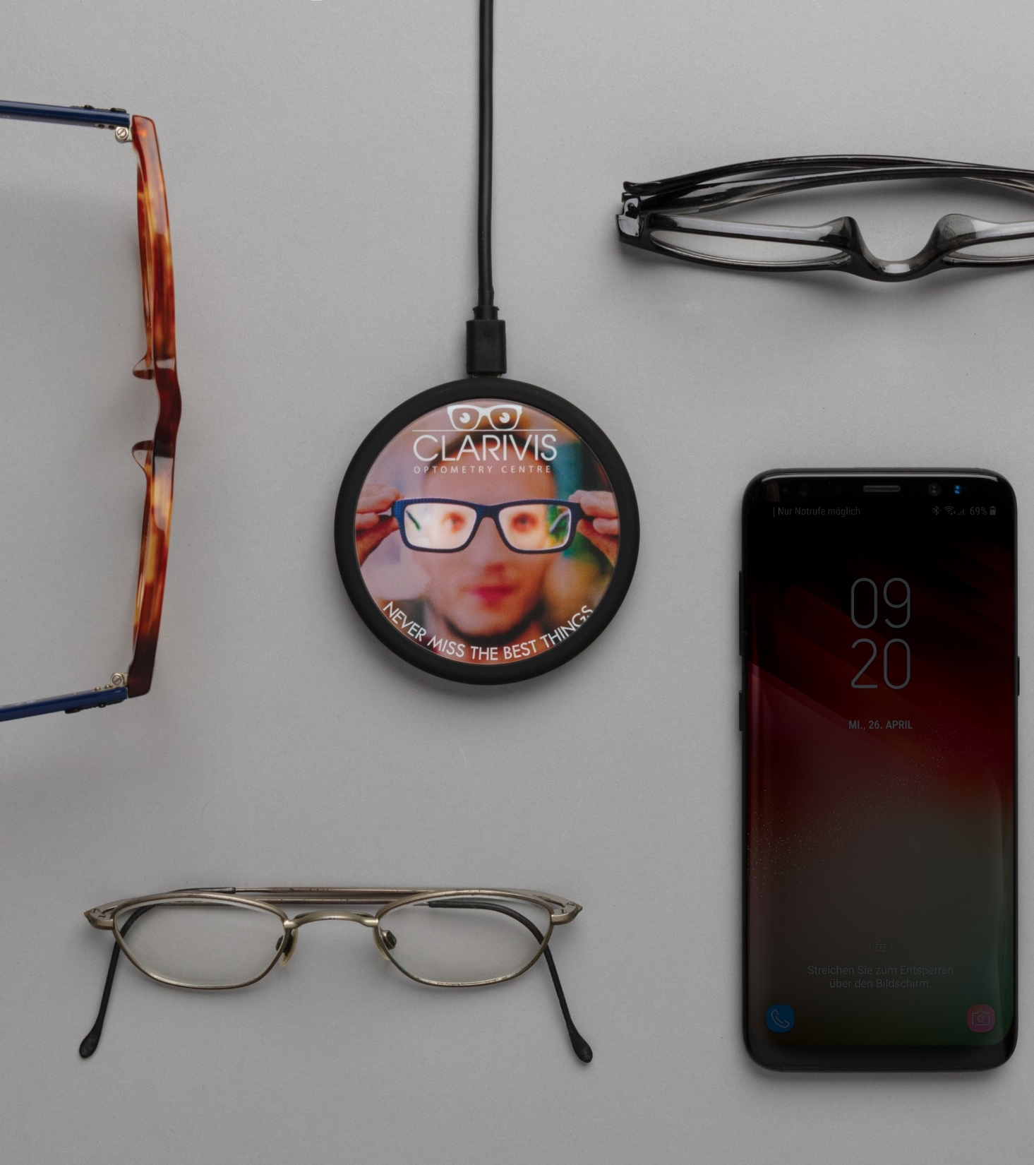
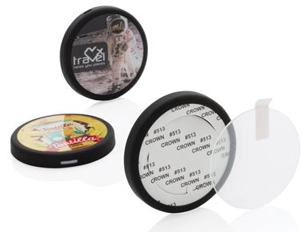
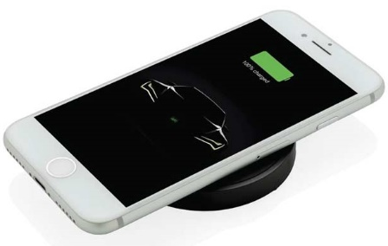
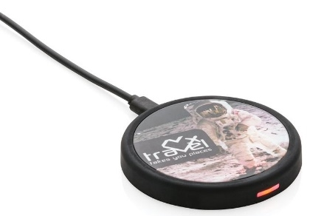
Rennes 5W Wireless Charger
Excellent BRing Space on Scratch-Proof Tempered Glass Surface
Wireless Output: 5W
Smooth Rubberised Surface
Quantity | Unit Price
100 | R
250 | R
500 | R
Notes:
ITWC 204

Slide 13
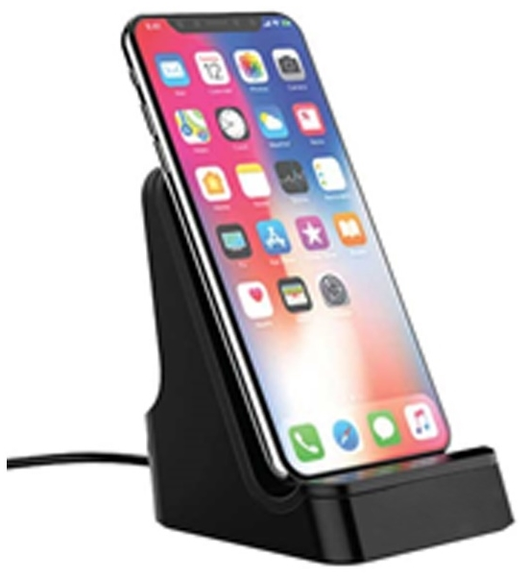
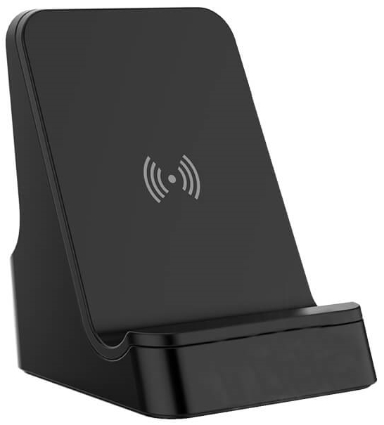
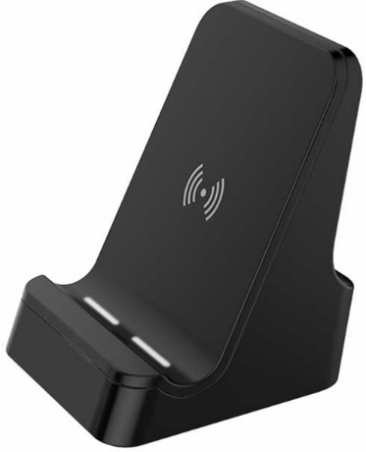
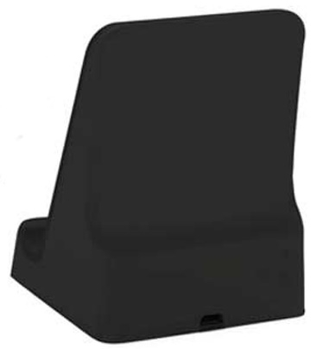
Corinto 5W Wireless Charger With Light Up Logo
5 WATT Wireless Charger
Including 100 cm Micro USB Cable
Light-Up Logo When Engraved
Quantity | Unit Price
100 | R
250 | R
500 | R
Notes:
ITWC 203

Slide 14
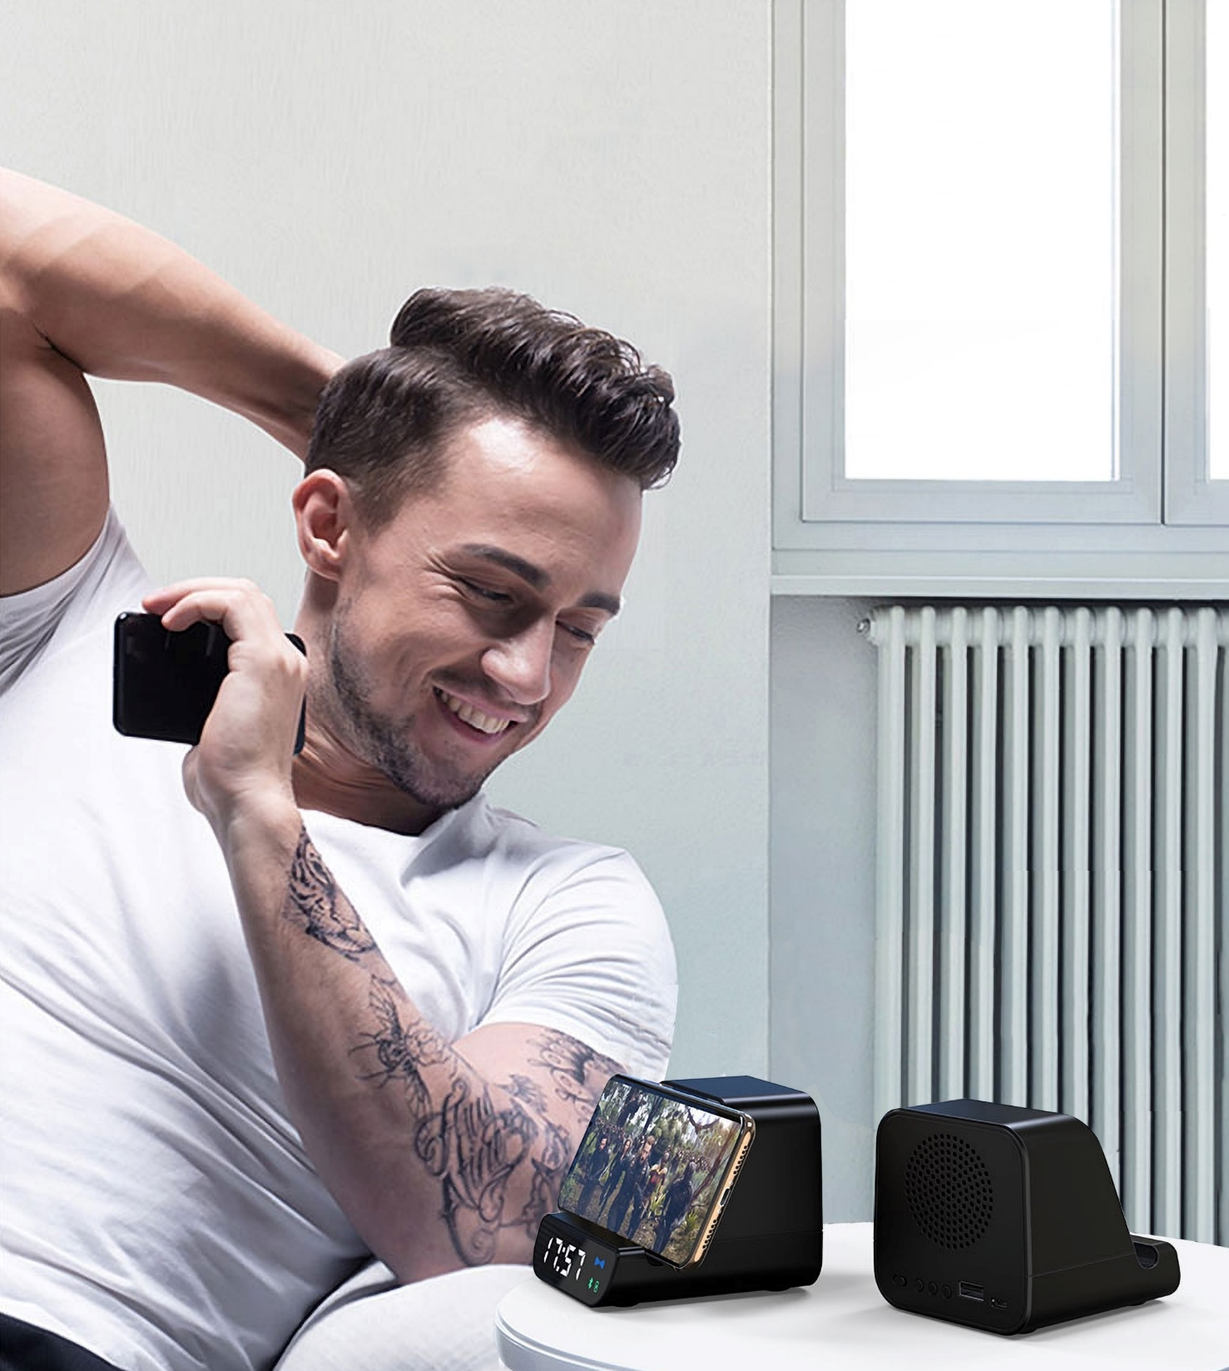
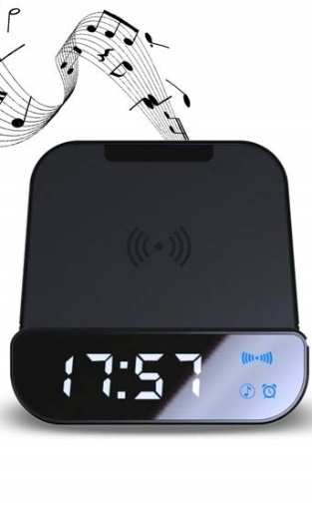
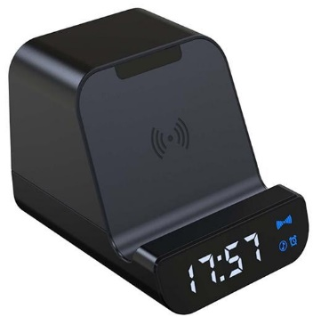
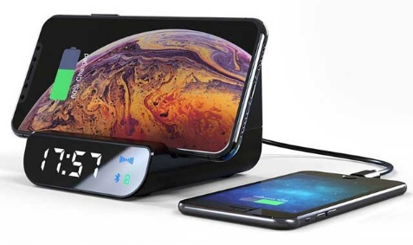
Somoto 5W Wireless 4000mAh Powerbank, Speaker & Alarm Clock
Powerful Sound Wireless Speaker with 10 hours playtime
5W Wireless Charger
Digital Alarm Clock
4000 mAh Built-in powerbank
Quantity | Unit Price
100 | R
250 | R
500 | R
Notes:
ITSP 204

Slide 15
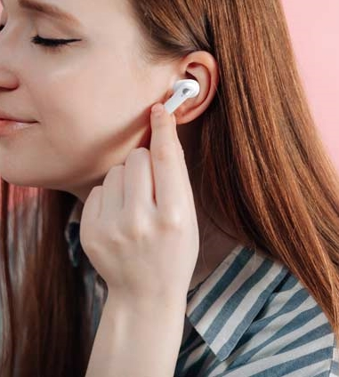
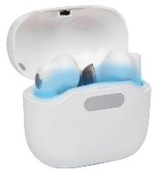
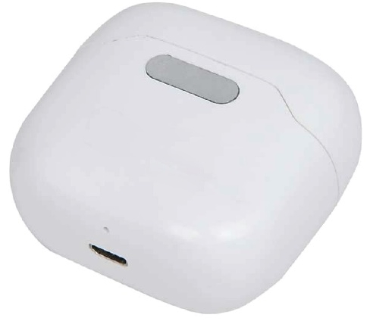
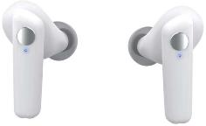
Skole TWS UV-C Earbuds With Sterilization Case
Equipped with UV sterilization, this TWS is cleaner and safer to use
Earbuds in the charging case and the UV will automatically sterilize the bacteria for 90 seconds
The earbuds have a 35 mAh battery and can be re-charged in the 400 mAh charging case
Quantity | Unit Price
100 | R
250 | R
500 | R
Notes:
ITBH 101

Slide 16
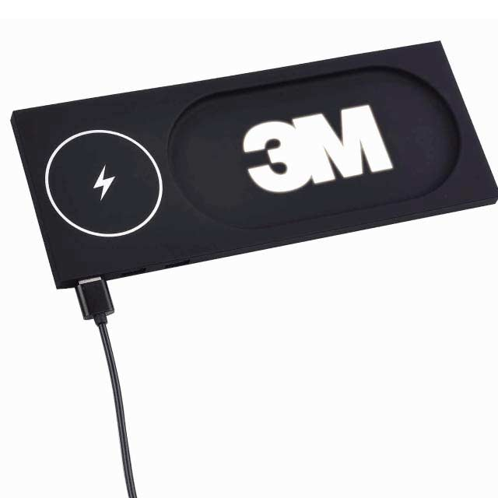
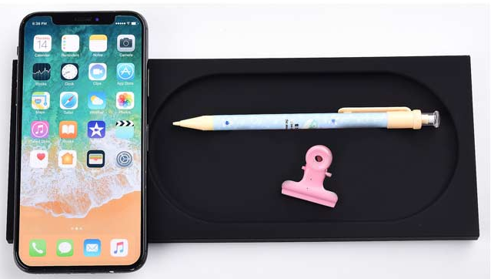
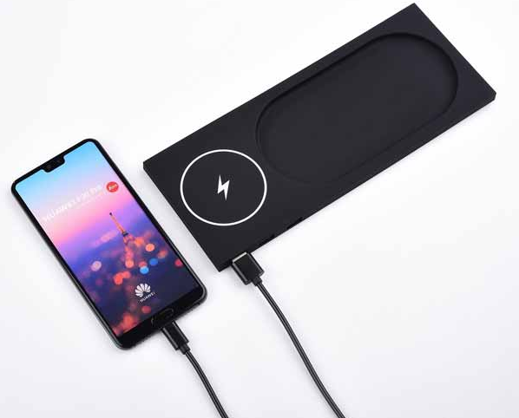
Cergy 5W Wireless Charger Desktop
Cergy is the perfect item for on your desk or table!
The light up logo area on the front allows for a large logo space with great visibility making it a perfect gift
This trendy desk organizer allows you to keep your desk tidy and charge your phone without any wires
Including 100 cm micro USB cable to connect the charger to a power source
5W wireless charging. Input DC 5V/ 1.5A. Output: 5V/800mA
Quantity | Unit Price
100 | R
250 | R
500 | R
Notes:
ITWC 205

Slide 17
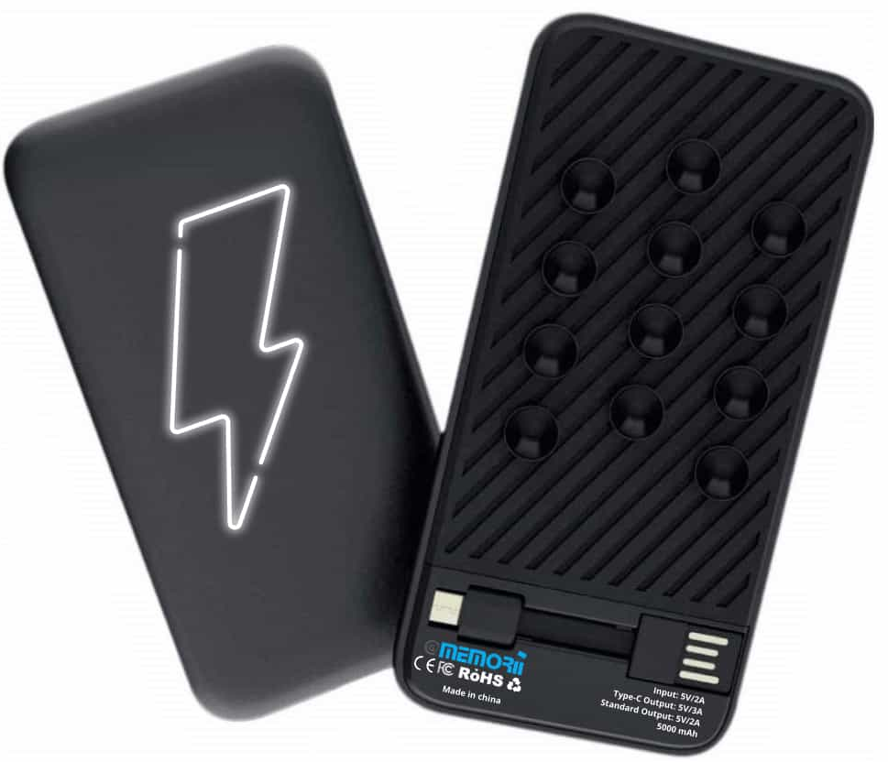
Sopot 5000 mAh Powerbank with Light-Up Logo
Sopot is a 5000 mAh powerbank with USB 2.0 input and Type-C output
The powerbank has the option for an engraved logo on the front panel
A set of 4 LED indicators display available power
Quantity | Unit Price
100 | R
250 | R
500 | R
Notes:
ITPB 463

Slide 18
Tigre UV-C Sterilization Box with 5W Wireless Charger
Kills upto 99.9% Bacteria
90 Seconds Quick Clean or 5 Minutes Complete Clean
Built-in 5W Wireless Charger
Quantity | Unit Price
100 | R
250 | R
500 | R
Notes:
ITSN 101

Slide 19
Grodno Soft Touch Insulated
Water Bottle – 500ml
Vacuum Insulated S.S. bottle
Cold for 10 hours, Hot for 5 hours 500 ml Capacity
Double Walled Leakproof
SS 304 inside SS 201 outside
Elegant Soft Touch
Quantity | Unit Price
100 | R
250 | R
500 | R
Notes:
DWGL 365, DWGL 367, DWGL 368, DWGL 366

Slide 20
Galati Canteen Reusable Water Bottle with Insulation – 450ml
Easy Grip, Flat Sides
SS 304 Inside, SS 201 Outside
Wide Mouth Fits Ice Cube
Screw-On Cap; BPA Free
12 Hours Cold And 8 Hours Hot
Quantity | Unit Price
100 | R
250 | R
500 | R
Notes:
DWHL 401, DWHL 403,DWHL 402

Slide 21
Eunoia Anti-Spill Suction Mug – Stainless Steel Insulated – 470ml
Quantity | Unit Price
100 | R
250 | R
500 | R
470 ml Anti-Spill Mug
Double Walled
Leak Proof Design
Anti-Fall Suction Base
Notes:
DWHL 205, DWHL 208

Slide 22
Lauta Set of Stainless Bottle, Notebook and Pen
Gift Set with colour matched items
Vacuum Bottle, Metal Pen and A5 notebook in gift box
All items with premium soft touch coating
Quantity | Unit Price
100 | R
250 | R
500 | R
Notes:
GSGL 861, GSGL 864, GSGL 863, GSGL 862

Slide 23
Almelo Insulated Drinkware Set
High quality, elegant set
Flask Capacity 600ml
Tumbler Capacity 180ml
Quantity | Unit Price
100 | R
250 | R
500 | R
Notes:
GSHL 102, GSHL 103

Slide 24
Argaki Gift Set Bottle, Notebook and Pen
SS Water Bottle with easy Grip & Flat Sides
Bottle, Notebook & Pen Set In Gift Box
Pen With German Dokumental® Ink
216 Pages Thermo PU Notebook
Quantity | Unit Price
100 | R
250 | R
500 | R
Notes:
GSSN 101

Slide 25
Habry UV-C Sterilization Pouch
Sterilise on the go
UV-C Kills 99.9% bacteria
2 different zippered compartments, for UV-C & for holding travel & daily accessories
Non Toxic Without Mercury
Use your own powerbank / power source or check with us for our range of powerbanks ( Pages 94 to 100 )
Quantity | Unit Price
100 | R
250 | R
500 | R
Notes:
ITSN 104

Slide 26
Jasper Office Laptop Briefcase
Office Laptop Bag from Premium Vegan Leather
Trolley strap attaches to trolley bag for ease of travel
Shoulder strap-on the go
Quantity | Unit Price
100 | R
250 | R
500 | R
Notes:
MBCRS 882, MBCRS 883, MBCRS 884

Slide 27
Francisco Office Laptop Briefcase
Office Laptop Bag from Premium Vegan Leather
Elegant Design
Shoulder strap-on the go
Quantity | Unit Price
100 | R
250 | R
500 | R
Notes:
MBCRS 881, MBCRS 887

Slide 28
Posadas 17” Laptop Backpack With USB Port
17” Laptop Backpack
Tablet Compartment
Structured Design For Easy Use
Integrated External USB Port
Quantity | Unit Price
100 | R
250 | R
500 | R
Notes:
BPSN 792

Slide 29
Tomar Set Of PU Thermo Notebook And Pen
216 Ruled Pages
Notebook & Pen Set In Gift Box
Pen With German Dokumental® Ink
Modern Notebook With Legendary Flair
Quantity | Unit Price
100 | R
250 | R
500 | R
Notes:
GSSN 403, GSSN 404

Slide 30
Campina Hard Cover Notebook with Metal Pen
Pen Attaches To The Magnet On The Notebook
160 Pages ; 80 gsm
Gift Box
Value Deal
Quantity | Unit Price
100 | R
250 | R
500 | R
Notes:
GSGL 301, GSGL 302, GSGL 303, GSGL 306, GSGL 305

Slide 31
Luzern Peak Pen
High Quality Ballpoint Pen
Sturdy Steel Exterior
Elegant Swiss Peak Sleeve
Quantity | Unit Price
100 | R
250 | R
500 | R
Notes:
WISW 810

Slide 32
Dusco Set Executive Pen Set
Authentic pen set bearing all the hallmarks of classic quality
High quality heavy brass metal rollerball with stylus and ball point pen with Swiss Peak bRing
Including premium PU leather pouch and giftbox. blue ink
Quantity | Unit Price
100 | R
250 | R
500 | R
Notes:
WISW 705

Slide 33
Trofa Metal Roller and Ball
Pen Set
Metal Pen Sets
Quantity | Unit Price
100 | R
250 | R
500 | R
Notes:
WIGS 203

Slide 34
Leova Pen (Anti-bacterial)
Treated with Japanese Antibacterial agent produced with SIAA Member
Great BRing Space on clip
Quantity | Unit Price
100 | R
250 | R
500 | R
Notes:
WIPP 820, WIPP 819, WIPP 818

Slide 35
Depok Pen (Anti-bacterial)
Treated for bacterial Effectiveness
1200m writing length
German Dokumental® Ink
Quantity | Unit Price
100 | R
250 | R
500 | R
Notes:
WIPP 822, WIPP 821, WIPP 823

Slide 36
Chester Bi-Fold Leather Wallet with Coin Pocket
CROSS® Genuine Leather Bi-Fold Wallet with Coin Pocket
Made with 100% Genuine Leather
Packed in a Gift Box with an authenticity card inside.
Quantity | Unit Price
100 | R
250 | R
500 | R
Notes:
LACRS 885

Slide 37
Ely Slim Leather Wallet
CROSS® Genuine Leather Bi-Fold Wallet with Coin Pocket
Made with 100% Genuine Leather
Packed in a Gift Box with an authenticity card inside.
Quantity | Unit Price
100 | R
250 | R
500 | R
Notes:
LACRS 886

Slide 38
Cancun Men's Wallet In Genuine Leather
Genuine Leather Men's wallet with contrast grey stitching
The inside of the wallet features 3 card slots, 2 section for banknotes and 1 coin pocket
A special tracker is built into the product to prove that the surface is treated with Biomaster
Packed in a Santhome gift box.
Quantity | Unit Price
100 | R
250 | R
500 | R
Notes:
LASN 652 BIO

Slide 39
Linkuva Genuine Leather Wallet
Genuine Leather Men's Mini Over-flap bifold wallet with space to keep all your pocket essentials
Features 9 Credit Card Pockets, 1 ID Pocket, 2 Slip in Pockets and a large bill compartment
Also features an ID pocket on the outside for easy access
Packed in a gift box
Quantity | Unit Price
100 | R
250 | R
500 | R
Notes:
LAGL 004

Slide 40
Thank you!
Your Name
M: +XX XX XXXX XXXX
E: email@template.com
W: https://sa.giftsnpromo.com/
Your Business Address
See 2023 catalogue
trendy | creative | sustainable | aspirational

